Slide 1
Deep Inside Convolutional Networks: Visualising Image Classification Models and Saliency Maps
K. Simonyan, A. Vedaldi, and A. Zisserman. Deep inside convolutional networks: Visualising image classification models and saliency maps. In Proc. ICLR, 2014.

Slide 2
Two visualization techniques of ConvNets
Class notion image
Saliency Map
Weakly supervised object segmentation
Deconvolutional networks

Slide 3
Dataset
ILSVRC-2013 dataset: 1.2M training images, labelled into 1000 classes.

Slide 4
Class Model Visualisation
Given a learnt classification ConvNet and a class of interest, the visualisation method consists in numerically generating an image [5], which is representative of the class in terms of the ConvNet class scoring model.
Notes:
a class of interest?

Slide 5
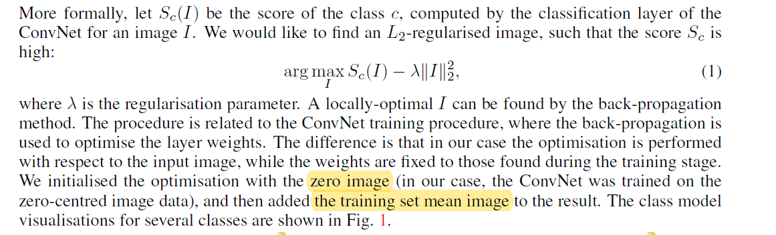
Class Model Visualisation

Slide 6
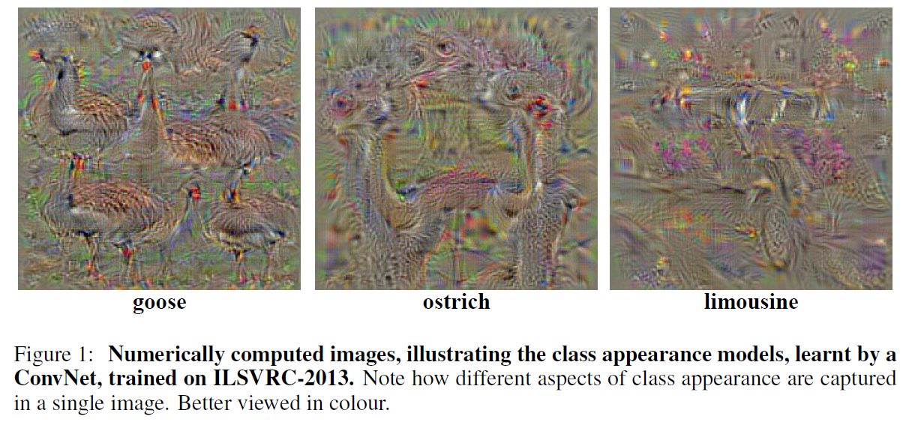
Notes:
goose：鹅
ostrich：鸵鸟
limousine: 高级轿车

Slide 7
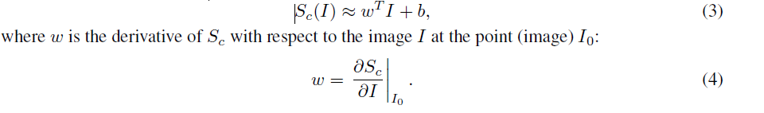
Image-Specific Class Saliency Visualisation
image I, class c, a classification ConvNet, score function S_{c}(I): rank the pixels of I based on their influence on the score S_{c}(I).
Linear Score Model:
Non-linear: However, given an image I₀, we can approximate S_{c}(I) with a linear function in the neighbourhood of I₀ by computing the first-order Taylor expansion:

Slide 8
Class Saliency Extraction
First, the derivative w is found by back-propagation. After that, the saliency map is obtained by rearranging the elements of the vector w.
Grey-scale image:
the number of elements in w is equal to the number of pixels in I
the map can be computed as M_{ij} = |w_{h(i,j)}|, where h(i,j) is the index of the element of w, corresponding to the image pixel in the i-th row and j-th column.
Multi-channel image:
M_{ij} = max_{c}|w_{h(i,j,c)}|.

Slide 9
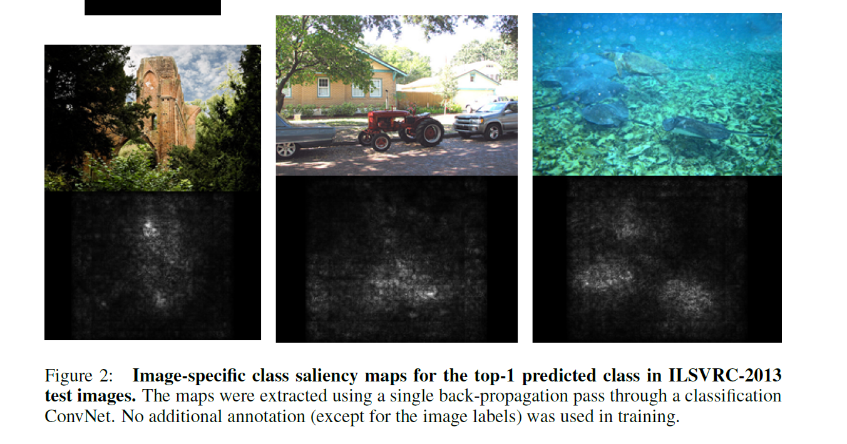

Slide 10
Weakly Supervised Object Localisation
Given an image and the corresponding class saliency map, we compute the object segmentation mask.
Fact: the saliency map might capture only the most discriminative part of an object
Foreground and background colour models were set to be the Gaussian Mixture Models.

Slide 11
Weakly Supervised Object Localisation
The foreground model was estimated from the pixels with the saliency higher than a threshold, set to the 95% quantile of the saliency distribution in the image; the background model was estimated from the pixels with the saliency smaller than the 30% quantile.
Once the image pixel labelling into foreground and background is computed, the object segmentation mask is set to the largest connected component of the foreground pixels (Fig. 3, right).

Slide 12
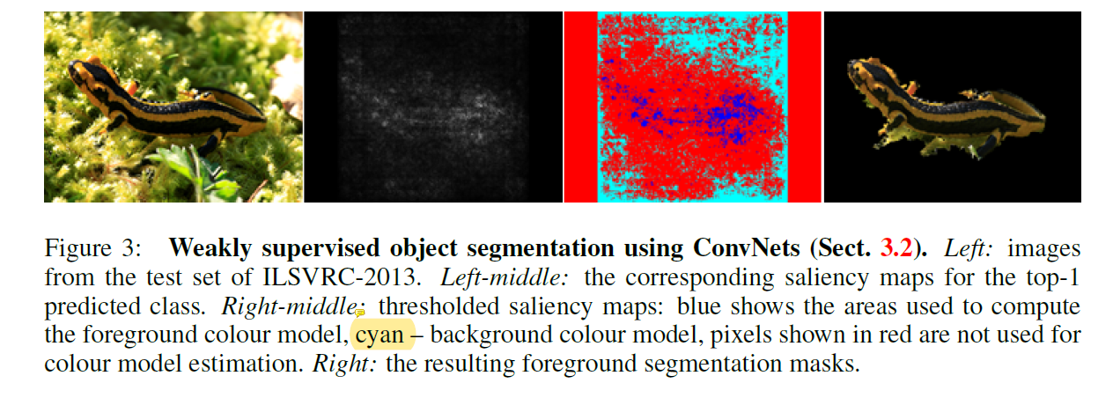

Slide 13
Relation to Deconvolutional Networks

